Slide 1

CUSTOMER DECISION Prediction

Slide 2
Contents
Introduction
Problem Statement
Data Collection
Dataset Description
Data Visualizations
Choosing Machine Learning Algorithm
Evaluation Model
Conclusion

Slide 3
INTRODUCTION
Consumer Behaviour is the study of individuals , groups , or organization and all the activities associated with the purchase , use and disposal of goods and services, including the customer emotional , mental and behavioural responses that precede or follow these activities .The consumer is that the focus of all the selling activities . Knowledge of his behaviour is one of the foremost and vital aspects of the selling activities.
Consumer behaviour does not stay identical or constant in each scenario it changes time to time .there are various factors which affect consumer behaviour .As the change comes in these factors , consumers behaviour also changes.

Slide 4
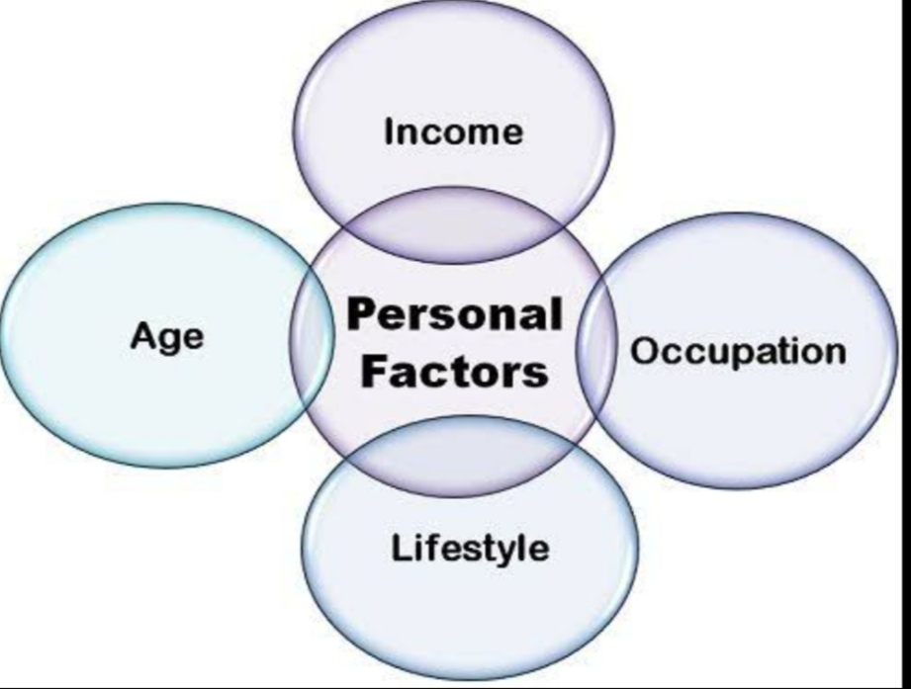
Factors affects Customer Behaviour

Slide 5
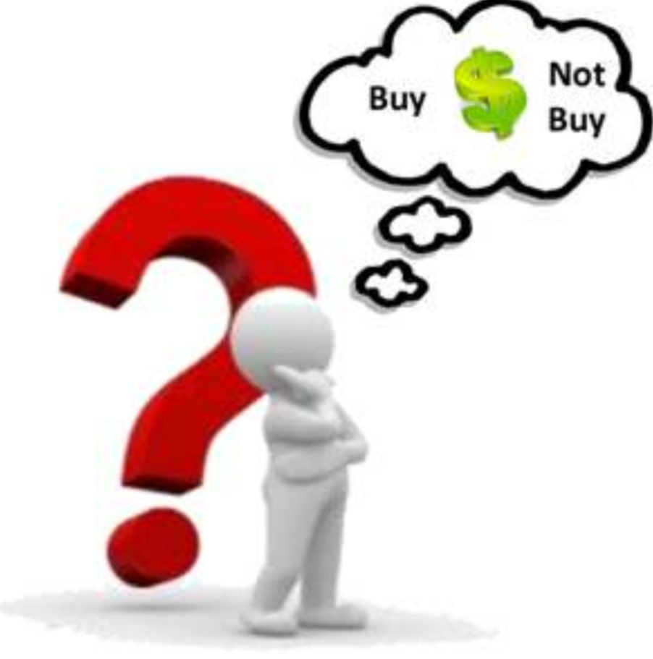
Problem Statement
To perform a good model which have high accuracy to predict Customer will purchase Product or Not.

Slide 6
DATAset description
1. ID - Unique identifier of a customer
2. STATE - Customer's state of residence
3. AGE - Customer's age
4. OCCUPATION - Customer's occupation
5. INCOME_GROUP - Customer's income band
6. CUSTOMER_SINCE - Year in which the customer made the first purchase at the store
7. LOYALTY_PROGRAM - Is the customer enrolled for the loyalty program?
8. PAST_PURCHASE - Total amount of past purchase from the same store
9. PURCHASE - Target variable(purchase or not)

Slide 7

Data Collection
The data we took from Kaggle, which facilitates was upload in numerical (Scaling) format.

Slide 8
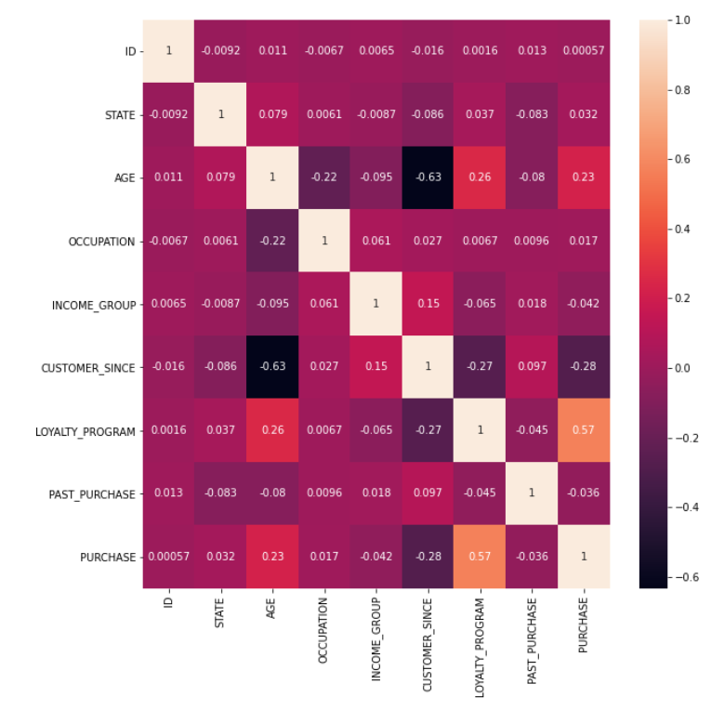
DATA visualizations
Conclusion:We can see that no column is highly correlated with the output, with a maximum correlation of 0.57 for “Loyalty program". Anyway, we will go ahead and use them all for our model.

Slide 9
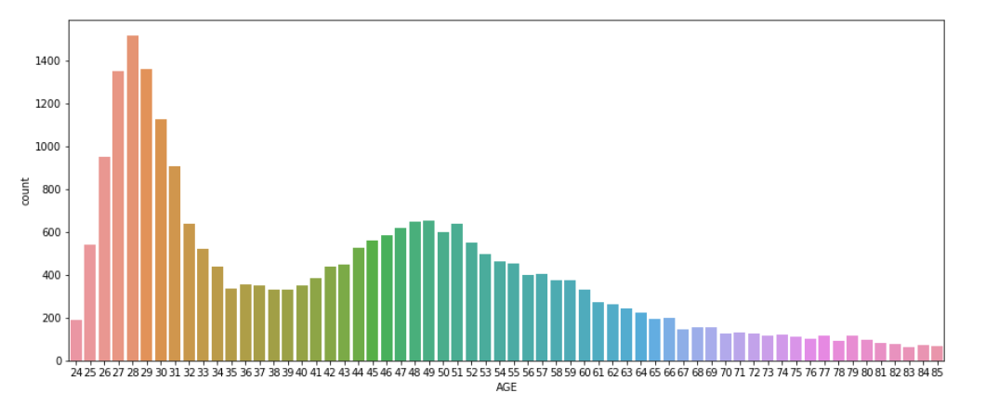
Conclusion:
Insight of dataset shows that People of age group between 26 to 32 are heavy buyers.

Slide 10
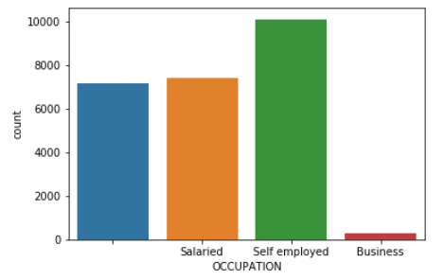
Conclusion:
From this plot,we see that Self Employed people Purchase more than other.

Slide 11
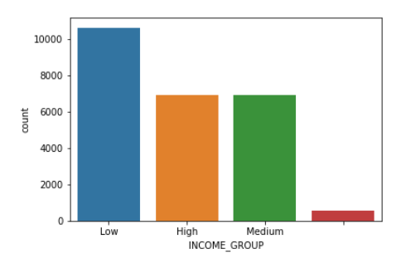
Conclusion:
from above plot, Person having low income Prefer to buy items from This Store.

Slide 12
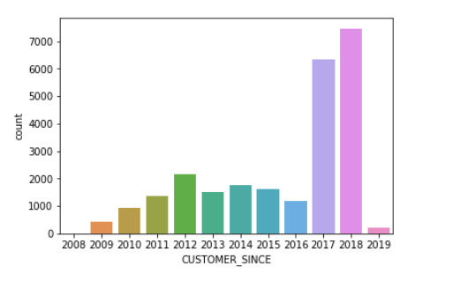
conclusion:
From above plot, we see that in year 2017 and 2018 more customer made the first purchase at the store.

Slide 13
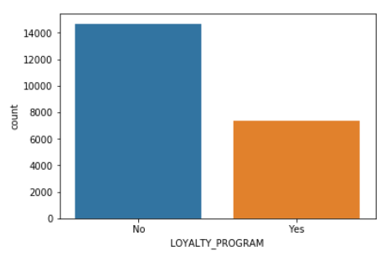
Conclusion:
From this graph , we see that more customer doesn't enrolled for the loyalty program.

Slide 14
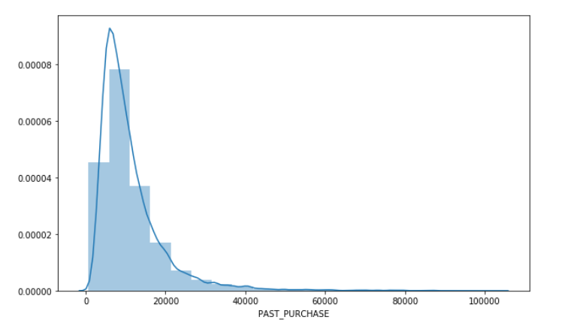
Conclusion:
from this graph we see that, more customer purchase total amount is maximum 20000.

Slide 15
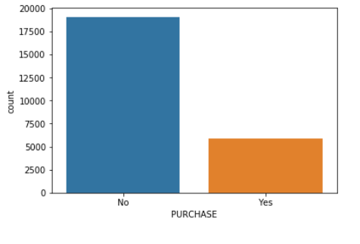
Conclusion:
From past data we conclude that ,more customer does not purchases product from this store.

Slide 16
CHOOSING MACHINE LEARNING ALGORITHM
The output of the report expected binary data that is in binary format. So that we run following algorithms
Logistic Regression
KNN
Random Forest Classifier
Decision Tree Classifier
Ada Boost Classifier
Gradient Boosting Classifier
XGBOOST
Bagging Classifier

Slide 17
Evaluation Model
The Accuracy for LogisticRegression is : 0.8384
The Accuracy for DecisionTreeClassifier is : 0.7842
The Accuracy for SVM is : 0.7606
The Accuracy for KNN is : 0.7106
The Accuracy for GNB is : 0.8406
The Accuracy for RandomForestClassifier is : 0.855
The Accuracy for AdaBoostClassifier is : 0.8564
The Accuracy for GradientBoostingClassifier is : 0.8598
The Accuracy for BaggingClassifier is : 0.8466
The Accuracy for XGBClassifier is : 0.8614

Slide 18
conclusion
Based on above data, we can conclude that XGBCLassifier is best suitable machine learning algorithm with Accuracy 86.14%
So, XGBClassifier model is best model for accurately classify The customer will purchase product or Not .

Slide 19


